Slide 1
DESCRIPTIVE STATISTICS
PELAGIA T MUYAMBIRI

Slide 2
Table of Contents
01
02
03
04
MIN
MAX
AVG
STDEV

Slide 3
DESCRIPTIVE STATISTICS
1
DEFINITION
Variables
2
Ways used to give a brief sum up of what the data in a given scenario is all about (F Kaliyadan, 2019).
It can touch on single variables or more than one variables.
4
Examples
Graphs Used
Min, Max, Avg and Stdev.
3
You can use graphs like histograms, bx plot, bar chart, pie chart and scatter plots

Slide 4
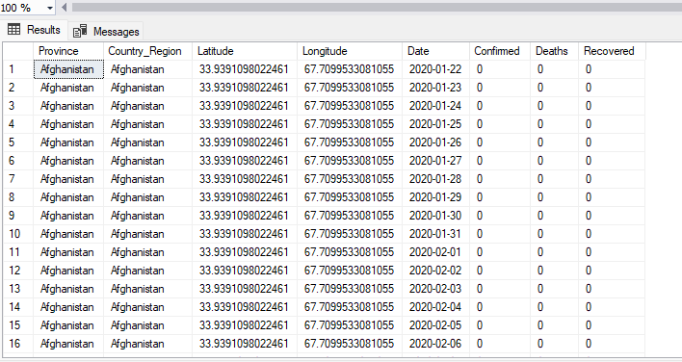
DATASET

Slide 5
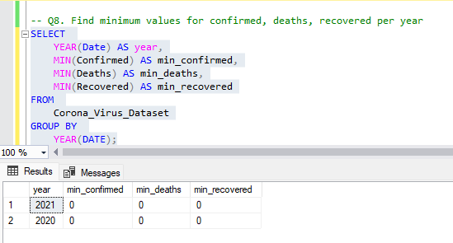
MIN
The min method is short or minimum and is used to show the lowest number for a variable in question.
If the variable in question is age, it shows the smallest number f nor the ages there in the dataset.
The method is shown by writing the min ad the paranthesis for example: min(age);

Slide 6
MAX
The max method is short or maximum and is used to show the highest number for a variable in question.
If the variable in question is age, it shows the highest number for the ages there in the dataset.
The method is shown by writing the max n ad the paranthesis for example: max(age);
Question
Find the maximum values for confirmed, deaths and recovered

Slide 7
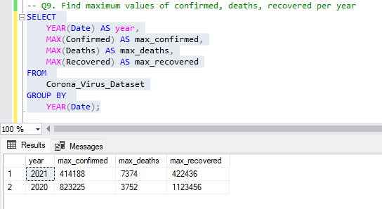
Answer

Slide 8
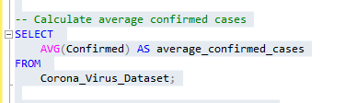
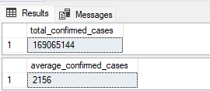
AVG
The avg method is short or average and is used to show the mean or average number for a variable in question.
If the variable in question is age, it shows the mean number for the ages there in the dataset.
The method is shown by writing the avg and the paranthesis for example: avg(age);

Slide 9
STDEV
The stdev method is short for standard deviation and is used to show the spread of data from the mean.
The method is shown by writing the stdev ad the paranthesis for example: stdev(age);
Question
Calculate standard deviation of confirmed cases

Slide 10
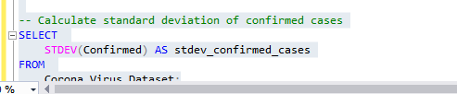
Answer

Slide 11
Thanks!
Do you have any questions or any areas you need clarity on?
Send them in the comment section so that we can help each other out

